Slide 1



Windows Phone and HTML5
Christian Helle
Commentor

Slide 2

Windows Phone and HTML5
Level 200
Notes:
Level 100 (Introductory);
Level 200 (Intermediate);
Level 300 (Experienced);
Level 400 (Advanced/Expert)

Slide 3
About me
Technical Lead at Commentor A/S
Mobile Developer (and everything related)
Built software for smart devices for the past decade
Unbiased multi-platform developer
Blog - http://christian-helle.blogspot.com
Email – christian@commentor.dk
Social media
Facebook
LinkedIn
@christianhelle

Slide 4
What to expect from this session
HTML5 enabled mobile web applications
Audio and video
Canvas
Geolocation
Web storage
Native applications
Embedding HTML5 content in a silverlight application
Windows Phone 7 Features
Integrating HTML5 and Windows Phone 7

Slide 5


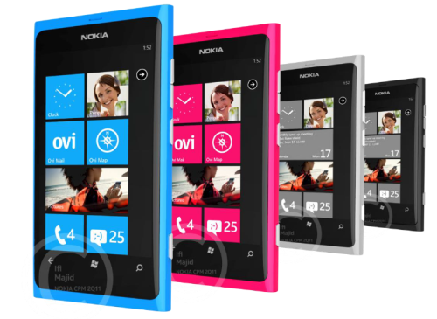

What to learn from this session
Incorporating HTML5 in modern mobile web and native apps
Learn about the tooling provided for the modern mobile developer
Appreciate the platform

Slide 6
Mobile Web Applications
HTML5 enabled mobile web sites

Slide 7
HTML5 Points of interest
Audio / Video
Canvas
Geo Location
Web Storage

Slide 8
<audio>
<video>
Attributes
src, autoplay, controls, loop, preload
Media events
onplay, onplaying, onprogress, onpause, onended, etc etc...
Javascript API
play(), pause(), volume, canPlayType(), load()
Attributes
src, autoplay, controls, loop, preload, height, width, muted, poster
Properties
currentSrc, currentTime, videoWidth, videoHeight, duration, ended, paused, muted, seeking, volume, height, width
Javascript API
play(), pause(), volume, canPlayType(), load()

Slide 9
<canvas>
Javascript 2D Drawing API
Manage state
Transformations
Alpha composition
Colors and styles
Lines, shadows, rectangles
Paths
Text
Images
Pixel manipulation

Slide 10
Geolocation
Enables location aware web sites
The browser must allow the site to use location services
Coordinates
Latitude, longitude, altitude, accuracy, altitudeAccuracy, heading, speed
Javascript API
getCurrentPosition(), watchPosition(), clearWatch()

Slide 11
Web Storage
Key/Value pair collection
Storage specific to a web page
Stores data as strings
Javascript API
localStorage – no expiration date
sessionStorage – per session
Data is deleted if History

Slide 12
The good
Truely cross-platform
Device independent
Operating system independent
Development environment and tools
Full control over content

Slide 13
The bad
Runs in the web browser
”Installing” requires the following steps
Launch Internet Explorer
Enter URL using the software input panel
Starts the app
Pin to start or add to favorites
Runs online
The platform is the web browser

Slide 14
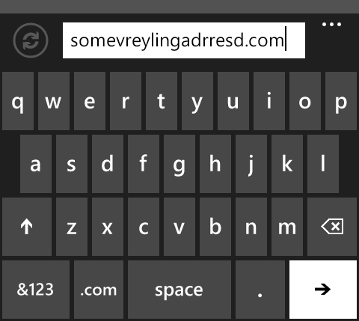
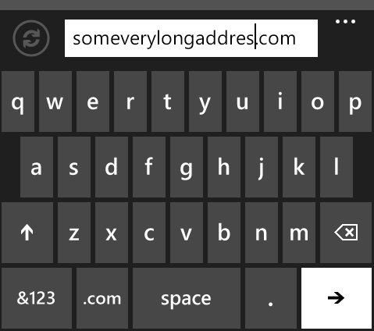
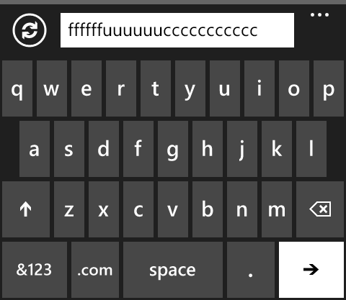





The ugly – mistyping the URL

Slide 15


The ugly – inapproriate branding
=

Slide 16
Mobile Web Applications
Demo
Creating HTML5 enabled mobile web applications

Slide 17
Native Applications
Using HTML5 content

Slide 18
Advantages
Fast launch
User Experience
More control over the platform
Performance
Deployment and updates
The user doesn’t know it’s a local web app in a nice box
Compensate for what HTML5 lacks

Slide 19
How?
Create a WP7 Silverlight project
Add a WebBrowser component
Set IsScriptEnabled to TRUE
Set IsGeolocationEnabled to TRUE
Handle ScriptNotify
Override the BACK key behavior
Add the HTML assets to the project
Write code to copy HTML assets to IsolatedStorage
Navigate the WebBrowser component to the main HTML page.

Slide 20
Native Applications
Demo
Creating a native application with HTML5 content

Slide 21
HTML5 + Windows Phone 7

Slide 22
Targeting devices
The platform is your best friend
Target the platform because it’s interesting
Take advantage of whatever the platform offers

Slide 23
Features
Alarms, reminders
Background agents
Background file transfer
Background audio
Sensors
Live Tiles
Launchers and choosers
Media
Sockets
Network Information
Device Status
Contacts and Calendar
Camera
Application bar
Push notifications
XNA
Advertising
Local database
Picture and Search extensibility
Progress indicators
License information API
Etc...

Slide 24
HTML5 + Windows Phone 7
User Interface using HTML5
Work flow using HTML5
Invoke platform features from Javascript
Handle script notifications from C#
Perform one way operations
Invoke Javascript callback methods

Slide 25
Browser Component
Javascript:
// host calls back with the image path
function captureImageCallback(args) {
var img = document.getElementId(”x”);
img.src = args;
}
Javascript:
// pass request meta data to host
window.external.notify(”captureImage”);
Silverlight
void CaptureImage
{
// captures the image using the Camera API
var path = CaptureImageFromCamera();
browser.NotifyScript(”captureImageCallback”,
new[] { path });
}
OnScriptNotify(object s, NotifyEventArgs e)
{
var metaData = e.Value;
if (metaData == ”captureImage”)
CaptureImage();
}

Slide 26
HTML5 + Windows Phone 7
Demo
Integrating with platform specific features of Windows Phone

Slide 27
PhoneGap
Kill 7 birds with 1 stone

Slide 28
Overview
Create native applications
Take advantage of HTML5 and CSS3
Use Javascript to write code
Access native platform features
Deploy to 7 different platforms
It’s still FREE!!!

Slide 29
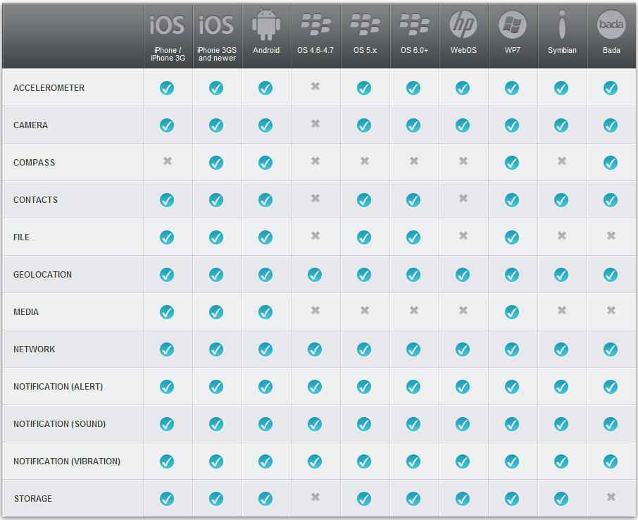

Slide 30
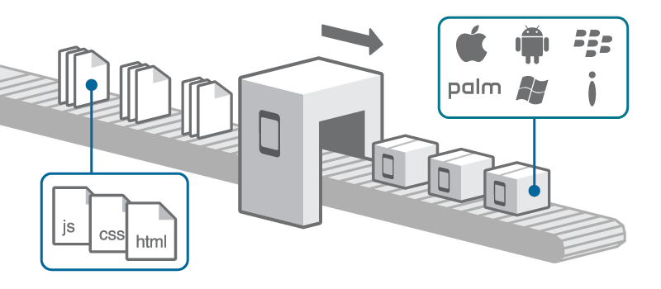
Build Service
Write your app using HTML, CSS and JavaScript
Upload it to the PhoneGap Build service
Get back app-store ready apps for Apple iOS, Google Android, Palm, Symbian, Blackberry and more.

Slide 31

Just because you can, it doesn’t mean you should

Slide 32




Q & A
Commentor
Udvikler fremtiden
Sammen med dig
Notes:
Se kommentarer til slide 12

Slide 33




http://
bit.ly/
ddc2012b02
Thank you to our 4 Platinum Sponsors!
Get the free app for your mobile at http://gettag.mobi
Notes:
Tags & Bit.ly adress for YOUR particular session will be provided before the Conference!
The tags on this slide will link you to a sample survey so you can test the functionality!
Please let us know if you have special requests around evaluations :o)

